Slide 1
Egg Runner
Brandon Huzil and Viktor Fries
CS 476 Project
The game

Slide 2
Problems
And
Motivations
When confronted with the task of deciding what to do for our Software Development Project, it became clear that we needed to work on a project that interested us and challenged us to learn skills that are good to have for the industry, and learn skills we would enjoy learning.
We decided that we would like to work on a game for our project, but what kind of game should we make, and how can we make a game the required us to use 3-tier software architecture.

Slide 3
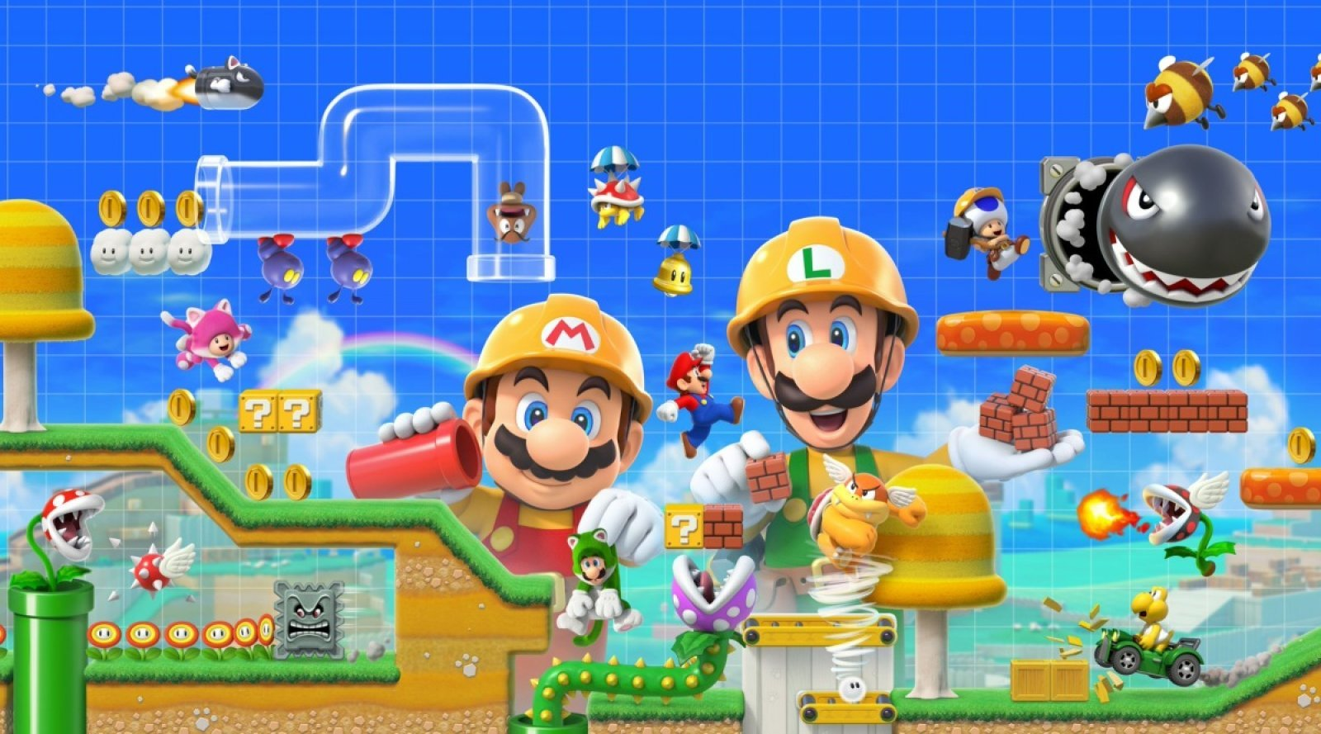
We looked at the current world of gaming for inspiration and found the perfect inspiration.
2015s Super Mario Maker and 2019s Super Mario Maker 2 by Nintendo found high success and ratings by taking the tried and true 2D Mario formula but gave players the tools to make their own levels and play the levels of others in the community. Unfortunately, if you wanted to play either game you needed both the games and the appropriate console. We wanted to tackle this problem.
And so we set out to create a simple online platformer with level editor and level database.

Slide 4
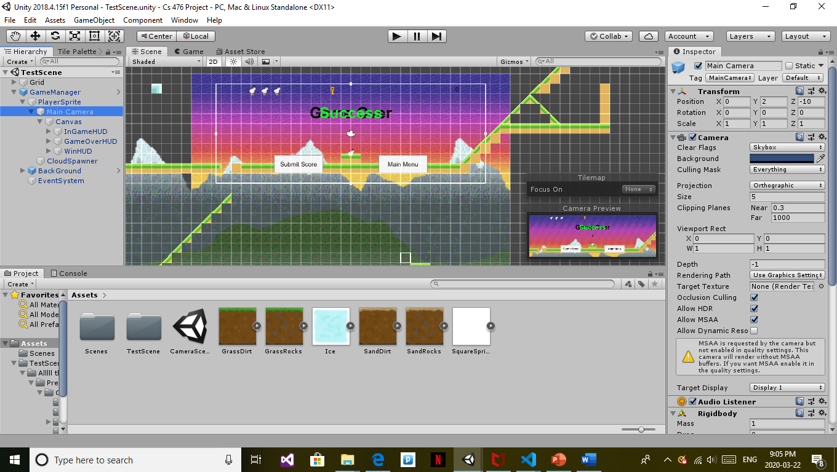
Main Functional requirements
We wanted the game logic to include a playable character with specialized camera, a collectable item for points, an enemy type to avoid that can trigger loss of health and death in the character, and a power up that can be used to destroy the enemy type.
We needed a level editor component that allowed users to place different tiles, as well as all the collectables, power ups, and enemies.
We needed a database to store levels to and retrieve them and keep track of player scores.

Slide 5
Design Patterns
In order to efficiently incorporate each game mechanic we made use of the spiral design pattern and embedded the prototyping model within it.
Determine a mechanic to add
Make use of prototyping to determine game logic implementation and iterate
Ensure Quality and that feature fits in both game logic and editor
Implement the prototype to work with existing mechanics and code

Slide 6
This spiral model also allowed us to add in components one at a time such that we have a new playable game after each mechanic addition.
Our background mechanic was easy to add because of this model, it worked by leap frogging two images over each other as a character moves side to side to create a never ending background that moves with the player and has a layered parallax effect.
Our game was at playable state before this mechanic, and it was at a playable state after this mechanic was added. This meant that if not all milestones were met we still had a usable product, or we could easily add new mechanics after reaching all milestones.

Slide 7
Design Patterns
Cont…
We also took inspiration form other design patterns for construction of certain components of our game, the mediator behavioural pattern worked wonders to lowly couple the communication between how we read a level and how we build a level.
The GameManager prefab object handled instantiation of all game objects at the correct locations and serverd to couple all game objects together with a common set of parent variables such as ensuring all local coordinates were based off of the global coordinates so one objects (x = 3, y = -10, z = 0) is another objects (x = 3, y = -10, z = 0).

Slide 8
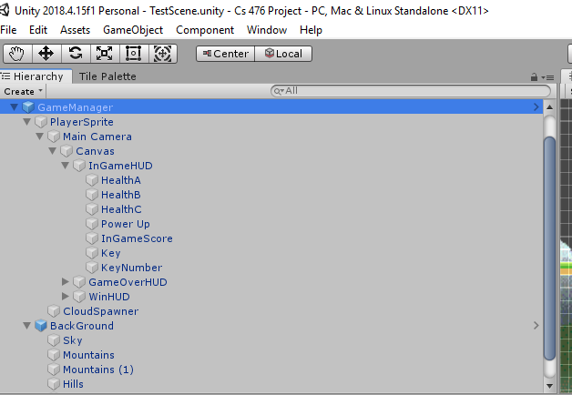
public void InitializeDoors()
{
// ensures all doors are closed
if (doors.Length > 0)
{
foreach (GameObject d in doors)
{
d.GetComponent<BoxCollider2D>().enabled = true;
d.GetComponent<SpriteRenderer>().color = new Color(1f, 1f, 1f, 1f);
}
}
// spawn in the doors at the correct locations
Quaternion roation = new Quaternion(0, 0, 0, 1);
doors = new GameObject[doorLocations.Length];
int i = 0;
foreach(Vector3 location in doorLocations)
{
doors[i++] = Instantiate(door, location, roation);
}
}

Slide 9
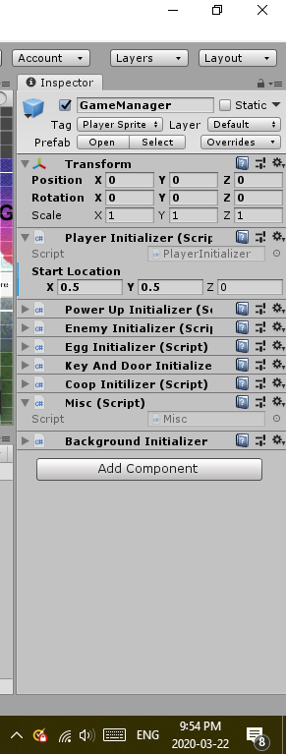
using System.Collections;
using System.Collections.Generic;
using UnityEngine;
public class BackgroundInitializer : MonoBehaviour
{
void Awake()
{
transform.GetChild(1).GetChild(0).GetComponent<SkyMover>().player = transform.GetChild(0).gameObject;
transform.GetChild(1).GetChild(1).GetComponent<MountainMover>().player = transform.GetChild(0).gameObject;
transform.GetChild(1).GetChild(1).GetComponent<MountainMover>().order = 2;
transform.GetChild(1).GetChild(2).GetComponent<MountainMover>().player = transform.GetChild(0).gameObject;
transform.GetChild(1).GetChild(2).GetComponent<MountainMover>().order = 1;
transform.GetChild(1).GetChild(3).GetComponent<HillMover>().player = transform.GetChild(0).gameObject;
transform.GetChild(1).GetChild(3).GetComponent<HillMover>().order = 2;
transform.GetChild(1).GetChild(4).GetComponent<HillMover>().player = transform.GetChild(0).gameObject;
transform.GetChild(1).GetChild(4).GetComponent<HillMover>().order = 1;
}
}

Slide 10
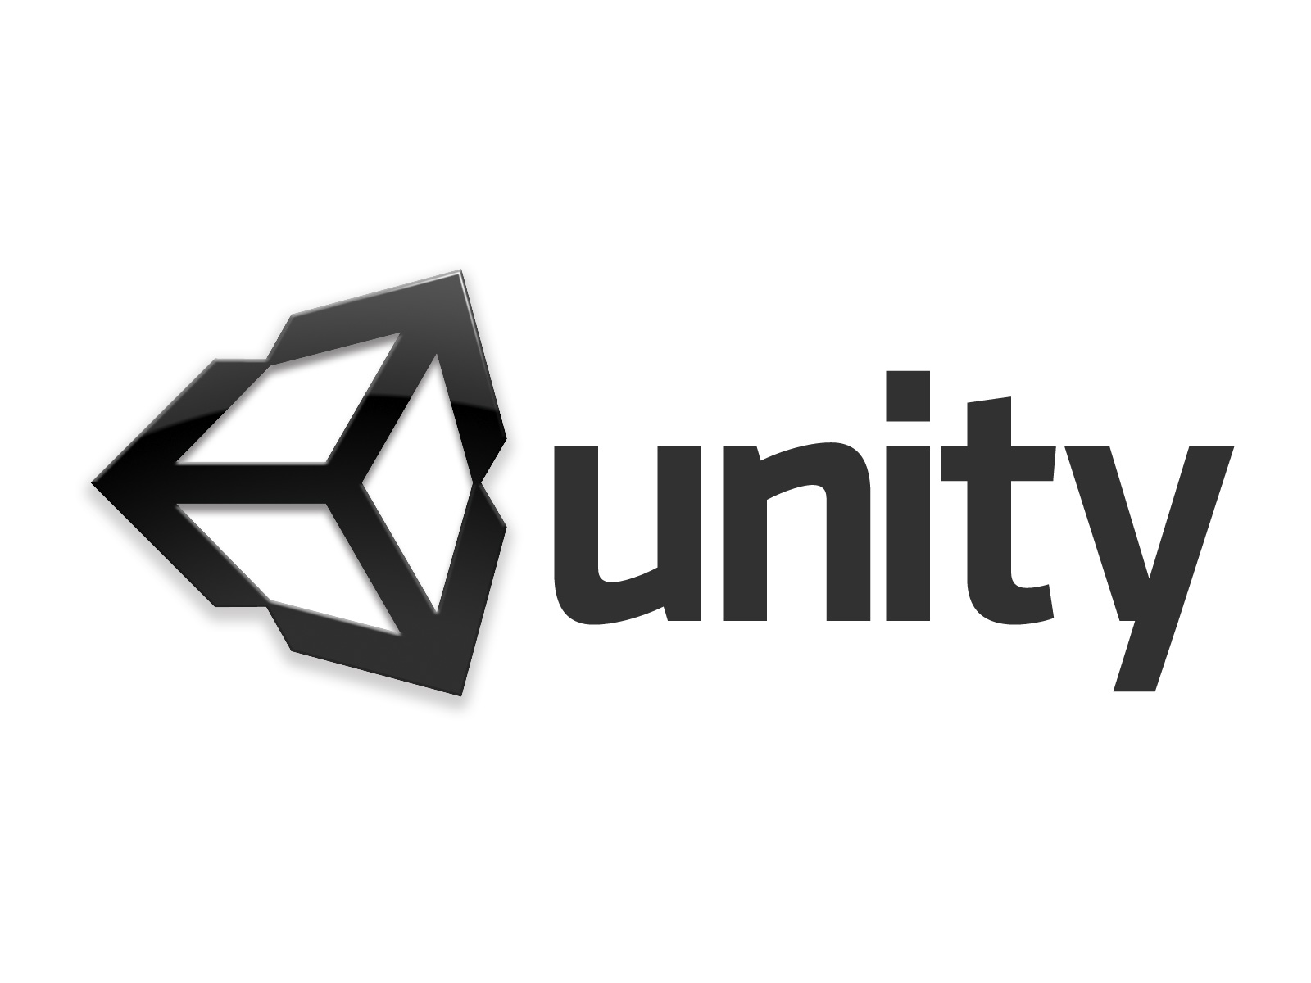
Software
Development
Tools
To Make our game we used the popular game engine Unity, using C# as our scripting language
Textures and sprites were made using Gimp
UML diagrams were made with Visual Paradigm

Slide 11
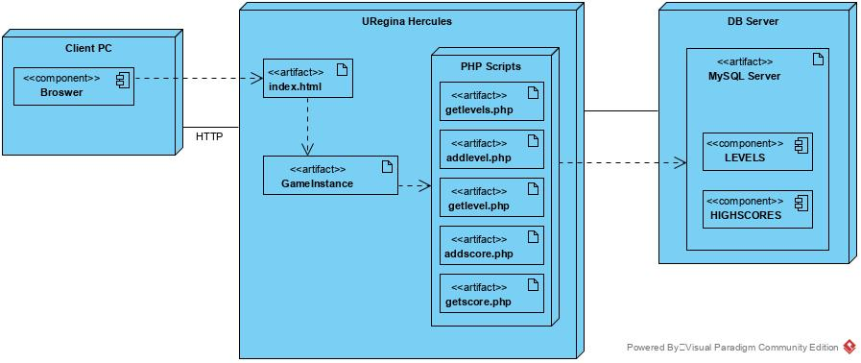
Class And Deployment Diagrams

Slide 12
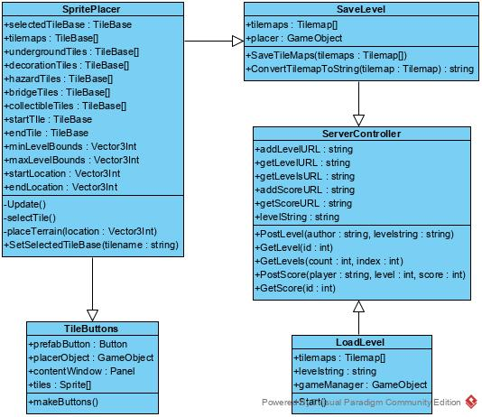
Class diagram of level editor components and some application layer components
These are just some of our class diagrams

Slide 13
Thanks for playing (we hope you will anyways)
Access to our game is though the following URL
Have fun populating our databases with your own levels and playing each others hand crafted adventures.
Run Chicken Run

